Slide 1
NEURAL STYLE TRANSFER
B.Tech Project - I [CO401]
By
Ritik Handa (2K17/CO/271)
Raghav Punjani (2K17/CO/249)
Rakshit (2K17/CO/259)

Slide 2
Abstract
We want to use machine learning programs to transfer daily pictures to artistic style images by using a style image for obtaining the transferred style and a content image which we want to transfer the style onto. This project can demonstrate how well machine learning techniques perform on image processing and how artificial intelligence can, to some extent, achieve considerable success in the field of art and creativity.
Current style transfer techniques such as Prisma emphasized more on the color and layouts of style image. Hence, the synchronized image might lose the color and distort the outline of the content image. In our project, we would like to explore a technique that could keep the features of content images as well as apply artistic styles from style images.

Slide 3

Introduction
Neural style transfer is an optimization technique used to take two images—a content image and a style reference image (such as an artwork by a famous painter)—and blend them together so the output image looks like the content image, but “painted” in the style of the style reference image.
This is implemented by optimizing the output image to match the content statistics of the content image and the style statistics of the style reference image. These statistics are extracted from the images using a convolutional network.

Slide 4
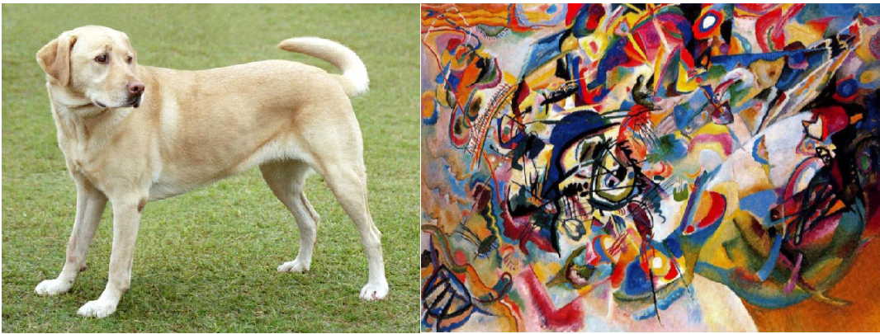
Introduction
Content Style

Slide 5
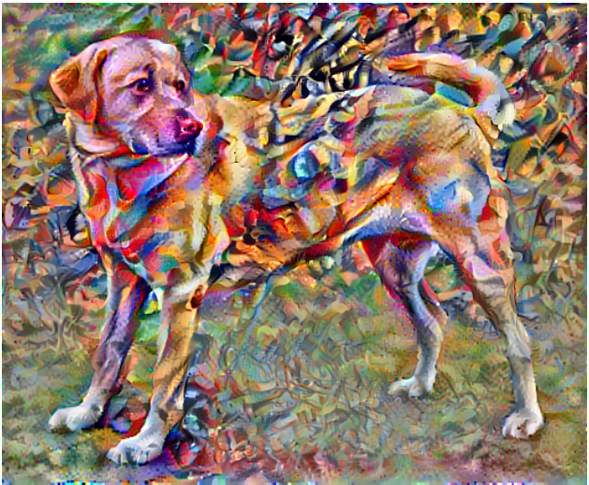
Introduction
Output

Slide 6
Convolutional Neural Network
A Convolutional Neural Network is a Deep Learning algorithm which can take in an input image, assign importance to various aspects/objects in the image and be able to differentiate one from the other.

Slide 7
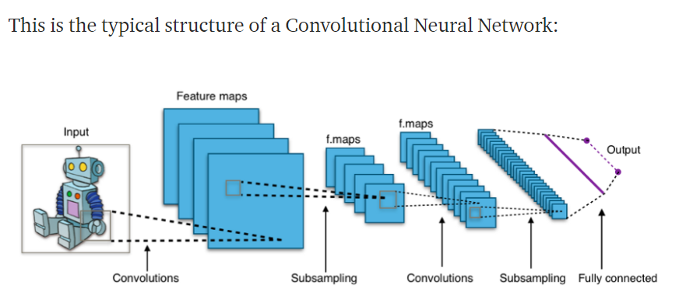
Convolutional Neural Network

Slide 8
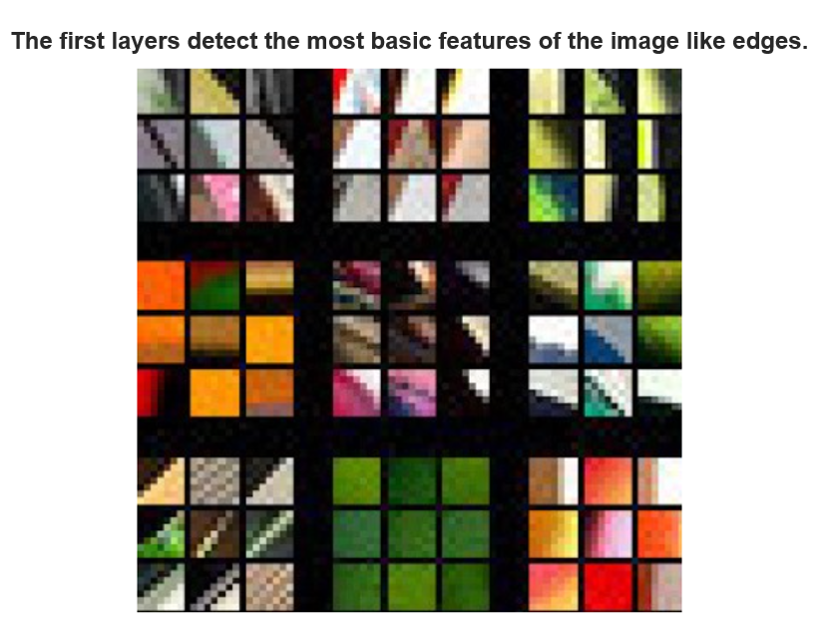
Convolutional Neural Network

Slide 9
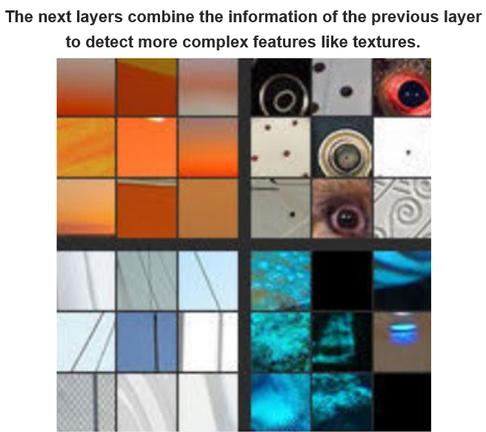
Convolutional Neural Network

Slide 10
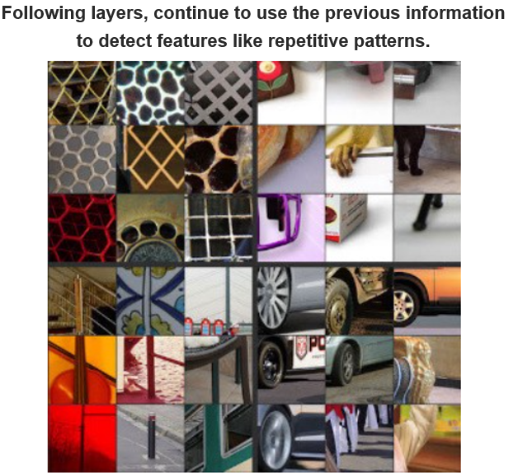
Convolutional Neural Network

Slide 11
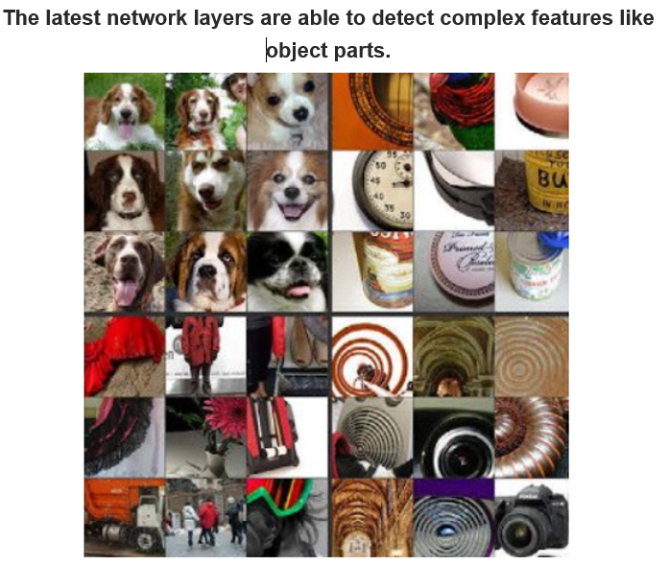
Convolutional Neural Network

Slide 12
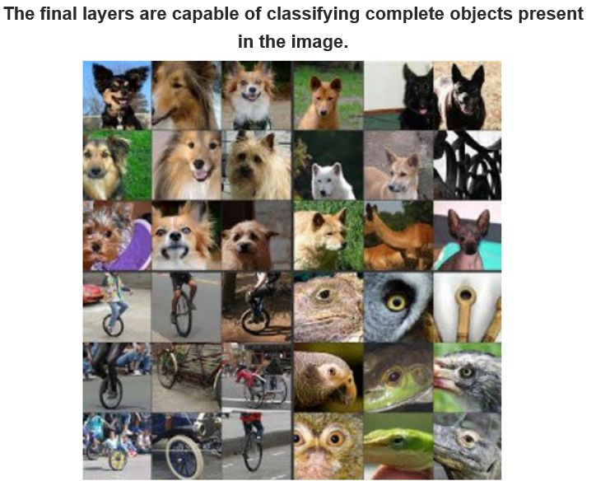
Convolutional Neural Network

Slide 13
APPLICATIONS
Due to the visually plausible stylized results, the research of NST has led to many successful industrial applications and begun to deliver commercial benefits

Slide 14
APPLICATIONS
NST ON AUDIO:
This algorithm can be used to produce new music by lovers and industry experts. New songs can be produced by recording sounds like content and music tone as a style.

Slide 15
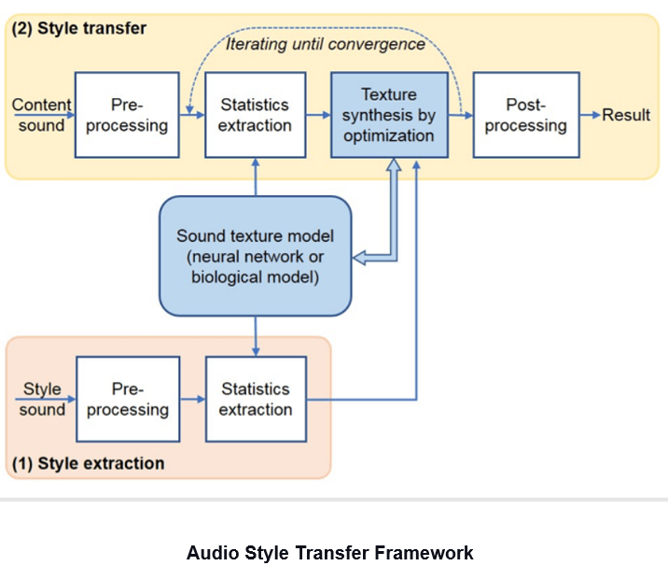
NST ON AUDIO:

Slide 16
Other Applications:
Social Communication
User-Assisted Creation Tools
Production Tools for Entertainment Applications
Augmenting Medical Data

Slide 17
Methodology
We will be using pre-trained convolutional neural networks libraries like keras have provided us with these giants and let us experiment with them on our own problem statements.
Next, we will define the layers from which we will extract our content and style characteristics.

Slide 18
Methodology
Loss Functions
To get the desired image we will have to define a loss function which will optimize the losses towards the required result. Here we will be using the concept of per pixel losses.
The loss terms we will be focusing on will be-
Content Loss
Style Loss

Slide 19
Methodology
Content Loss
It makes sure the content we want in the generated image is captured efficiently. It has been observed that CNN captures information about the content in the higher levels of the network, whereas the lower levels are more focused on the individual pixel values.

Slide 20
Methodology
Style Loss
The style information is measured as the amount of correlation present between the feature maps per layer. Here we use the Gram Matrix for computing style loss.
Gram Matrix
Gram matrix is the measure by which we capture the distribution of features over a set of feature maps in a given layer. So while you are basically computing or minimizing the style loss you are making the level of distribution of features the same in both of the styles and generated images.

Slide 21
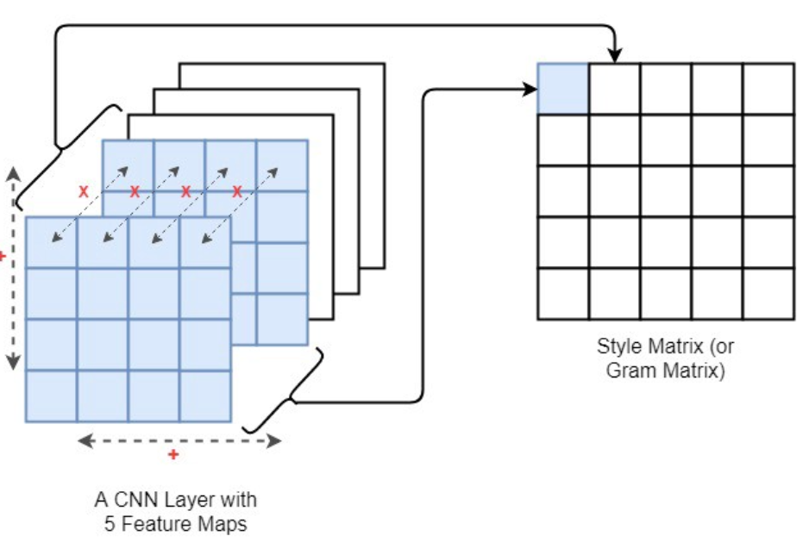
Methodology
Style Loss

Slide 22
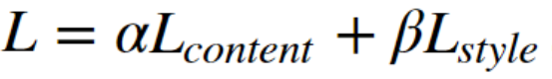
Methodology
Final Loss
we will compute a weighted summation of both the computed content and style losses to calculate the final loss.
Finally, we would have to define an optimizer(Adam or SGD) that would optimize the loss of the network.

Slide 23
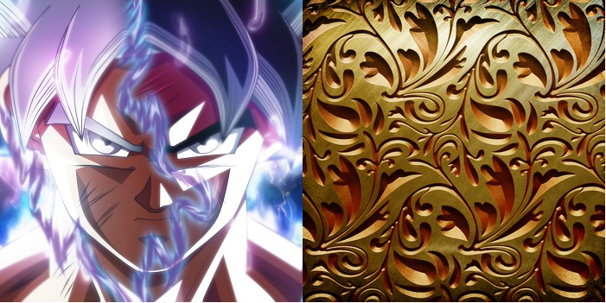
Results
Content Image Style Image

Slide 24
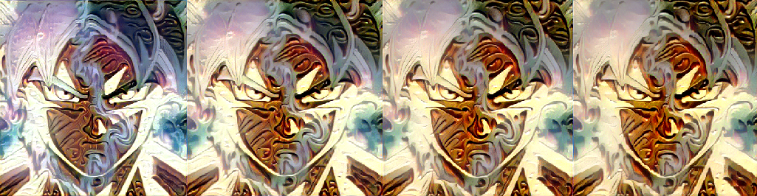
Results
Iteration 1 iteration 2 iteration 3 iteration 4

Slide 25
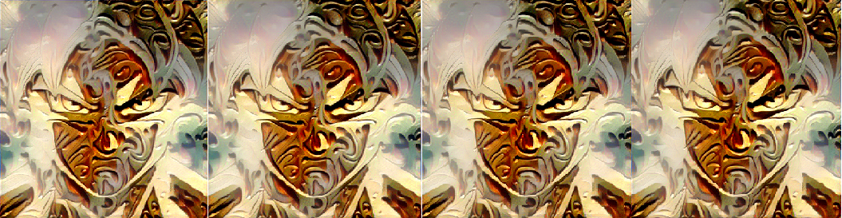
Results
Iteration 5 iteration 6 iteration 7 iteration 8

Slide 26
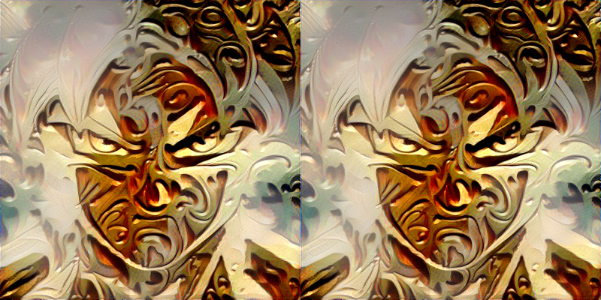
Results
iteration 9 iteration 10

Slide 27
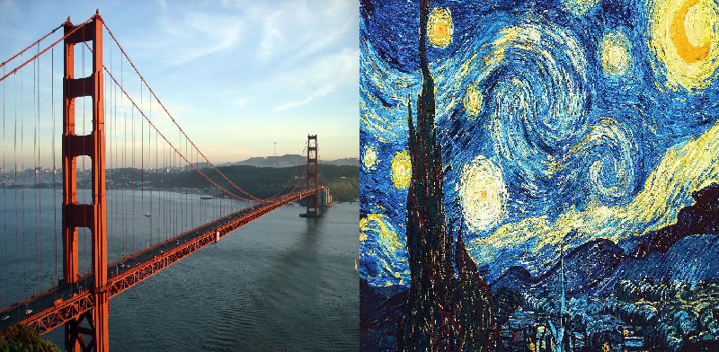
Results
Content Image Style Image

Slide 28
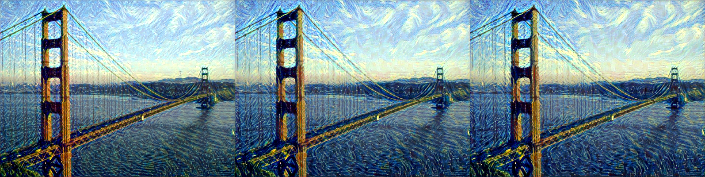
Results
iteration 1 iteration 2 iteration 3

Slide 29
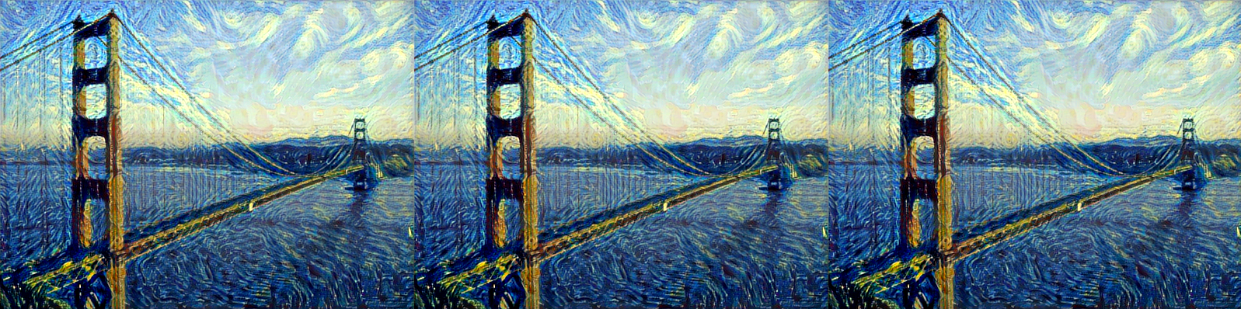
Results
iteration 4 iteration 5 iteration 6

Slide 30
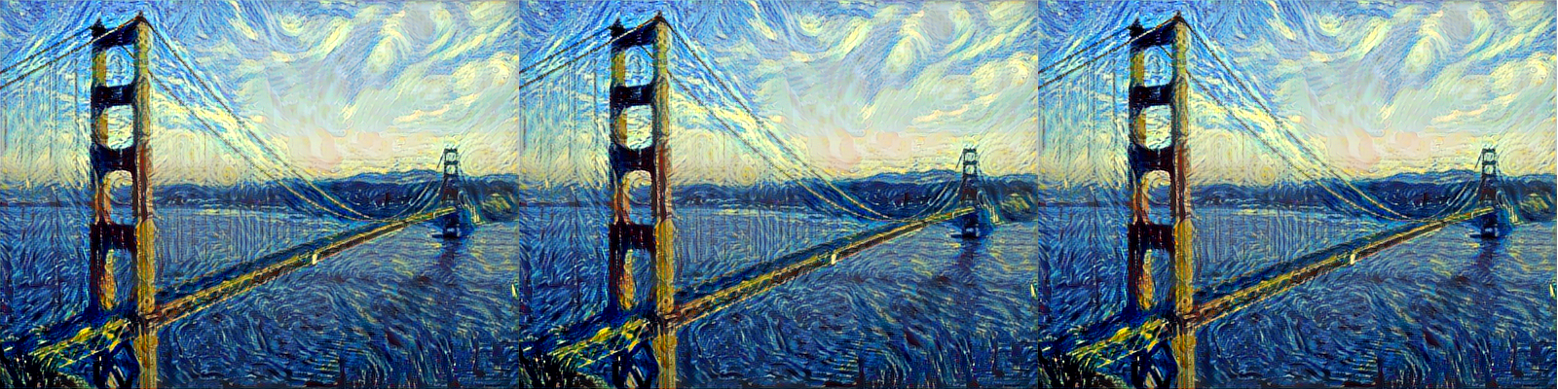
Results
iteration 7 iteration 8 iteration 9

Slide 31
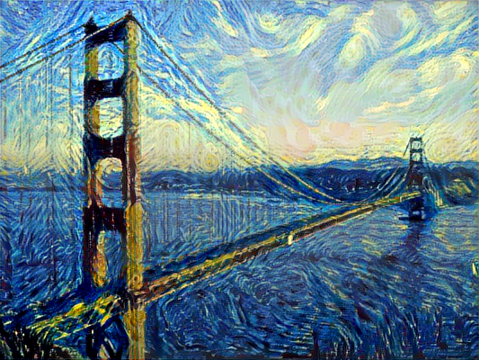
Results
Iteration 10

Slide 32
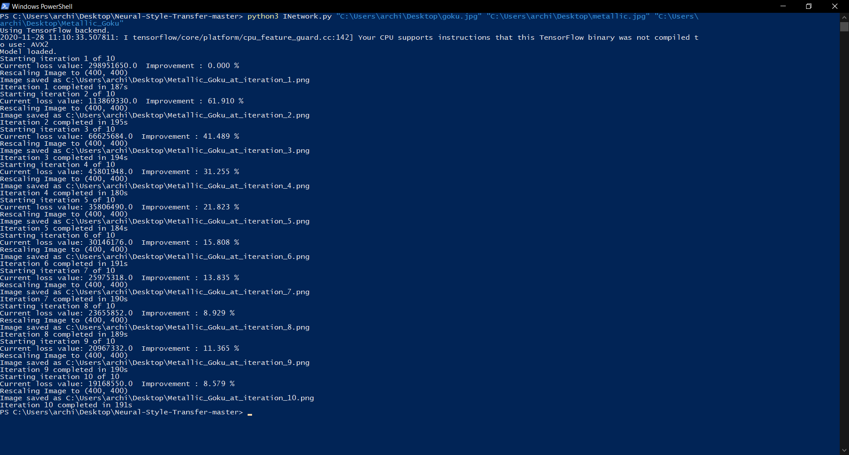
Results
Iteration 10

Slide 33
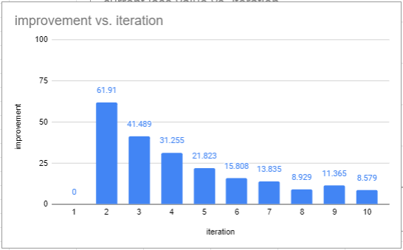
Results

Slide 34
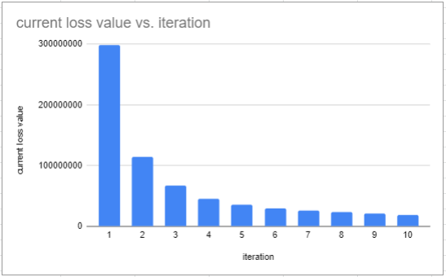
Results

Slide 35
THANK YOU

